Slide 1

- Hotel Booking Demand -
Group 2 :
Eddy,Oillio, David,Jeff
Notes:
Hallo everyone, today our group will talk about ‘Hotel Booking Demand’ @

Slide 2

01
02
Business Question
Data Collection
TABLE OF CONTENTS
03
04
Preprocessing
Models Creation
05
06
Model Evaluation and
Comparison
Conclusion and Future
Improvement
Notes:
this is the 6 main contents we like to share @

Slide 3

01
Business Question
Notes:
Business Question @

Slide 4

Business Question
More or less special requests will affect the cancellation?
Relationship between different groups of lead time?
Relationship between cancellation and deposit type
Predict a guest will actually come or not?
Where do the guests come from?
Booking the hotel through the agent will affect the cancellation?
How many customer type do we have?
Which month have the highest number of cancellation?
Which country have the highest number of cancellation?
How many booking were canceled?
Notes:
first of all , imagine you are the hotel CEO. you want to know :@
why so many booking cancel?
how many booking canceled ?
which country have the highest number of cancellation?
and a lot of questions….
not worry,@ we builded some model for you to figure out . it would be nice for the hotel to predict a guest will actually come or not.
this can help a hotel to launch more booking discount at the right time.
maybe some hotel also use such a model to plan things like personal and food requirements.@

Slide 5

02
Data Collection

Slide 6
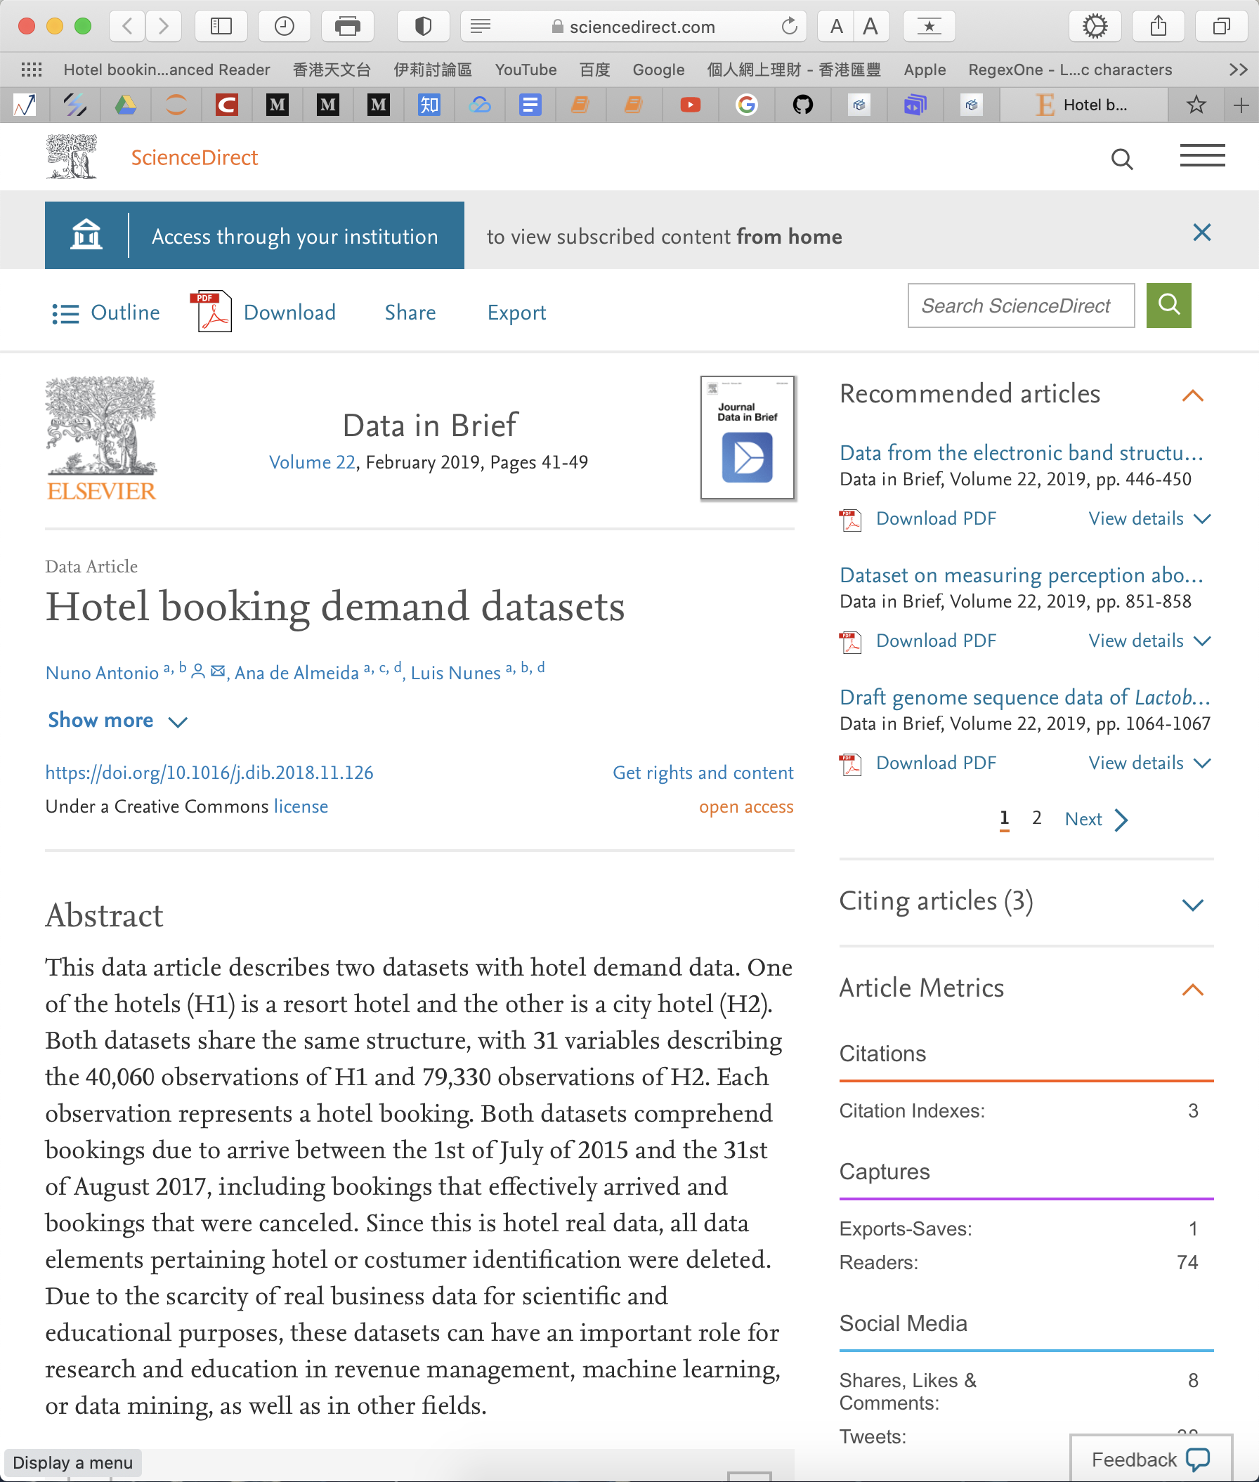
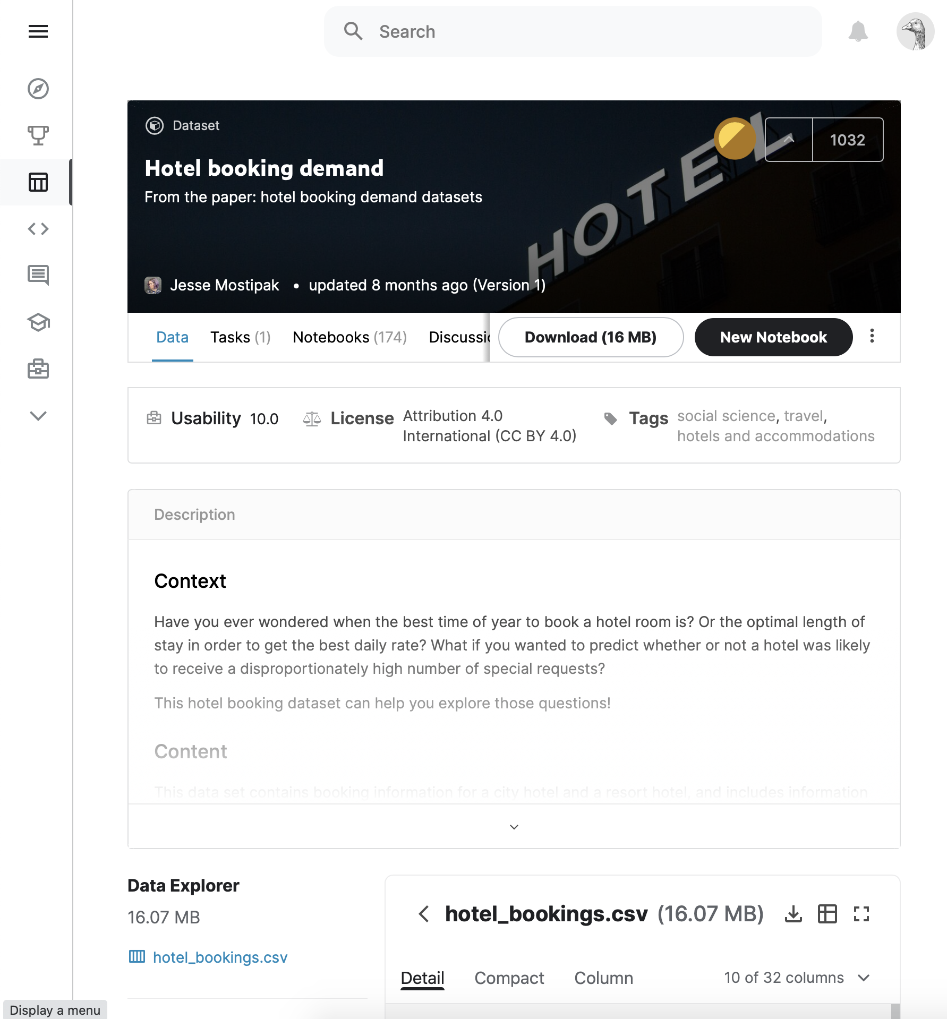
kaggle.com
Data Collection
sciencedirect.com
Notes:
we collect the data from 2 website ‘science direct.com’ and ‘kaggle.com’.

Slide 7

03
Preprocessing
Notes:
preprocessing @

Slide 8
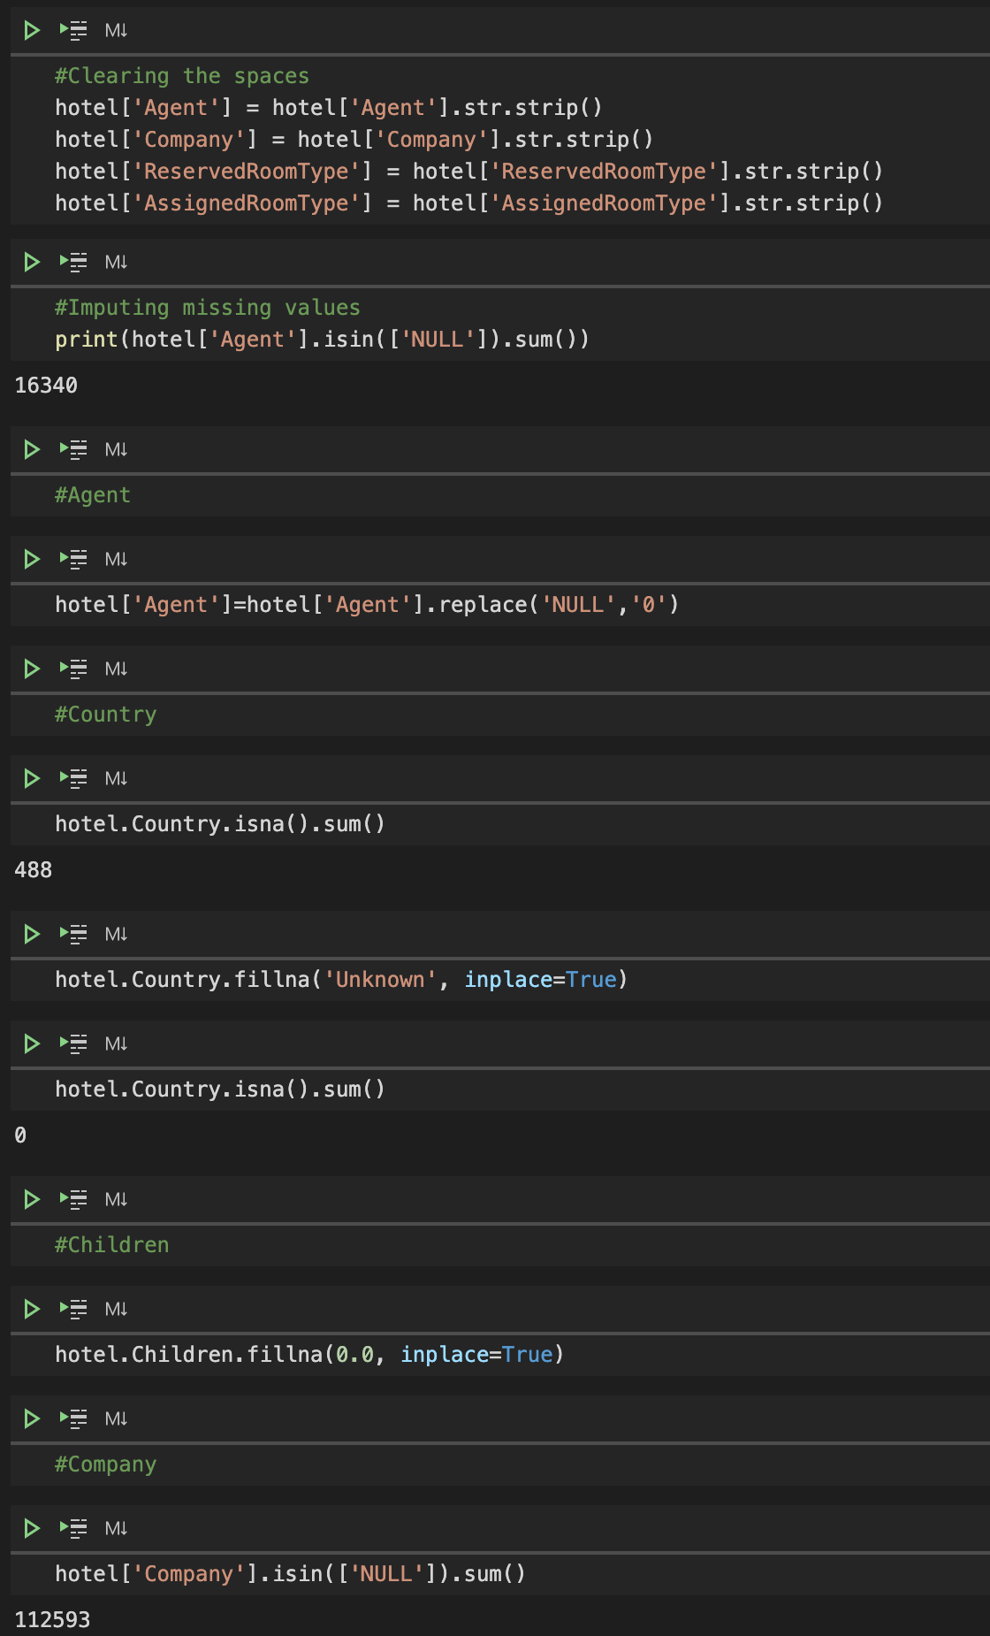
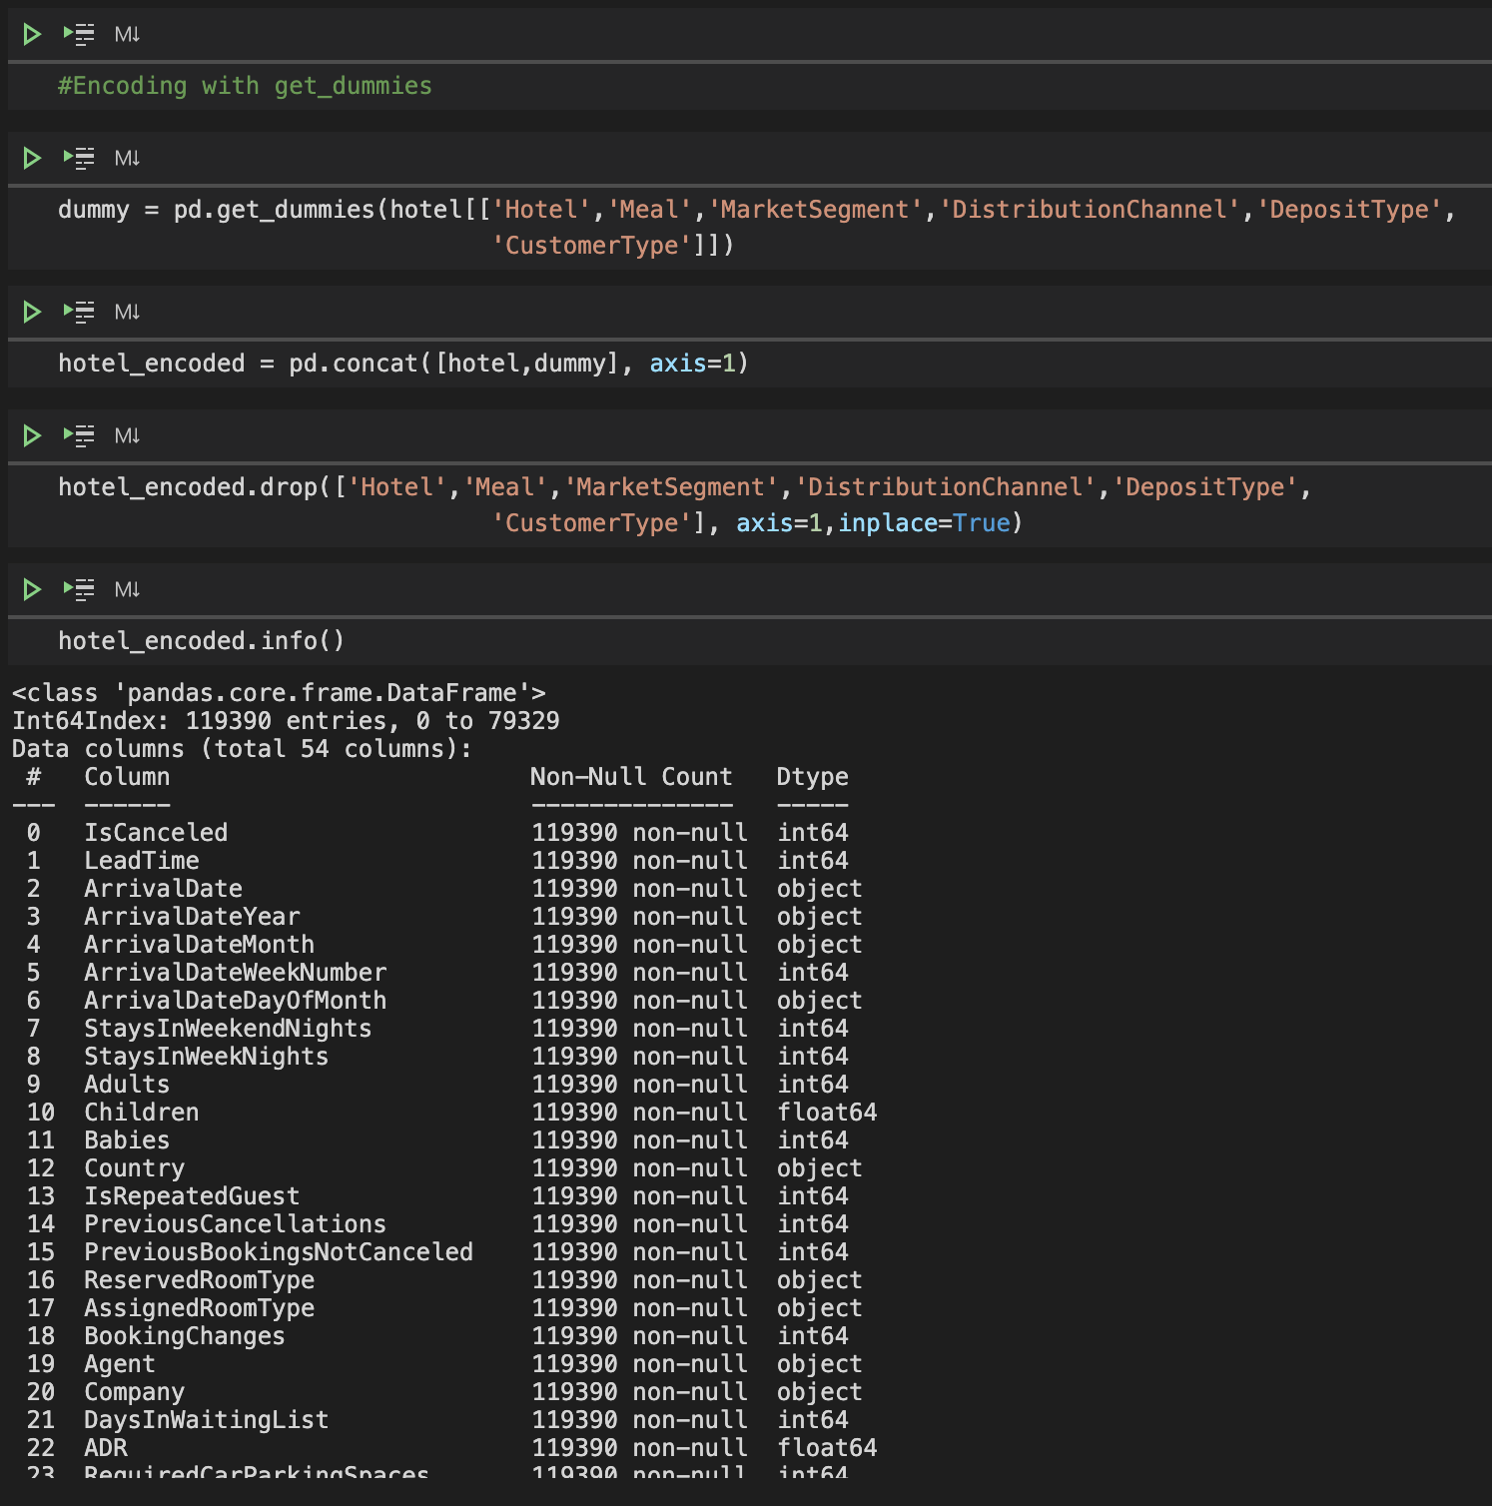
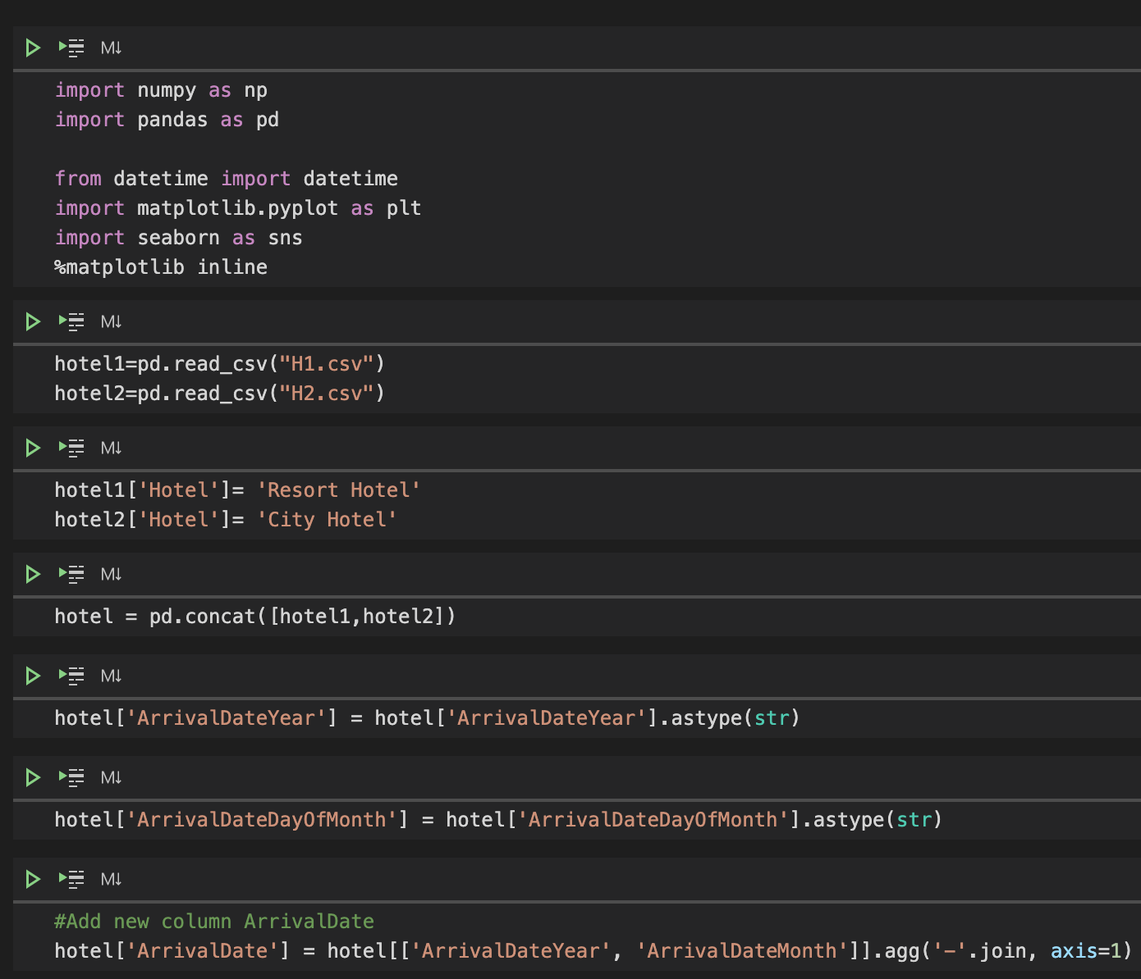
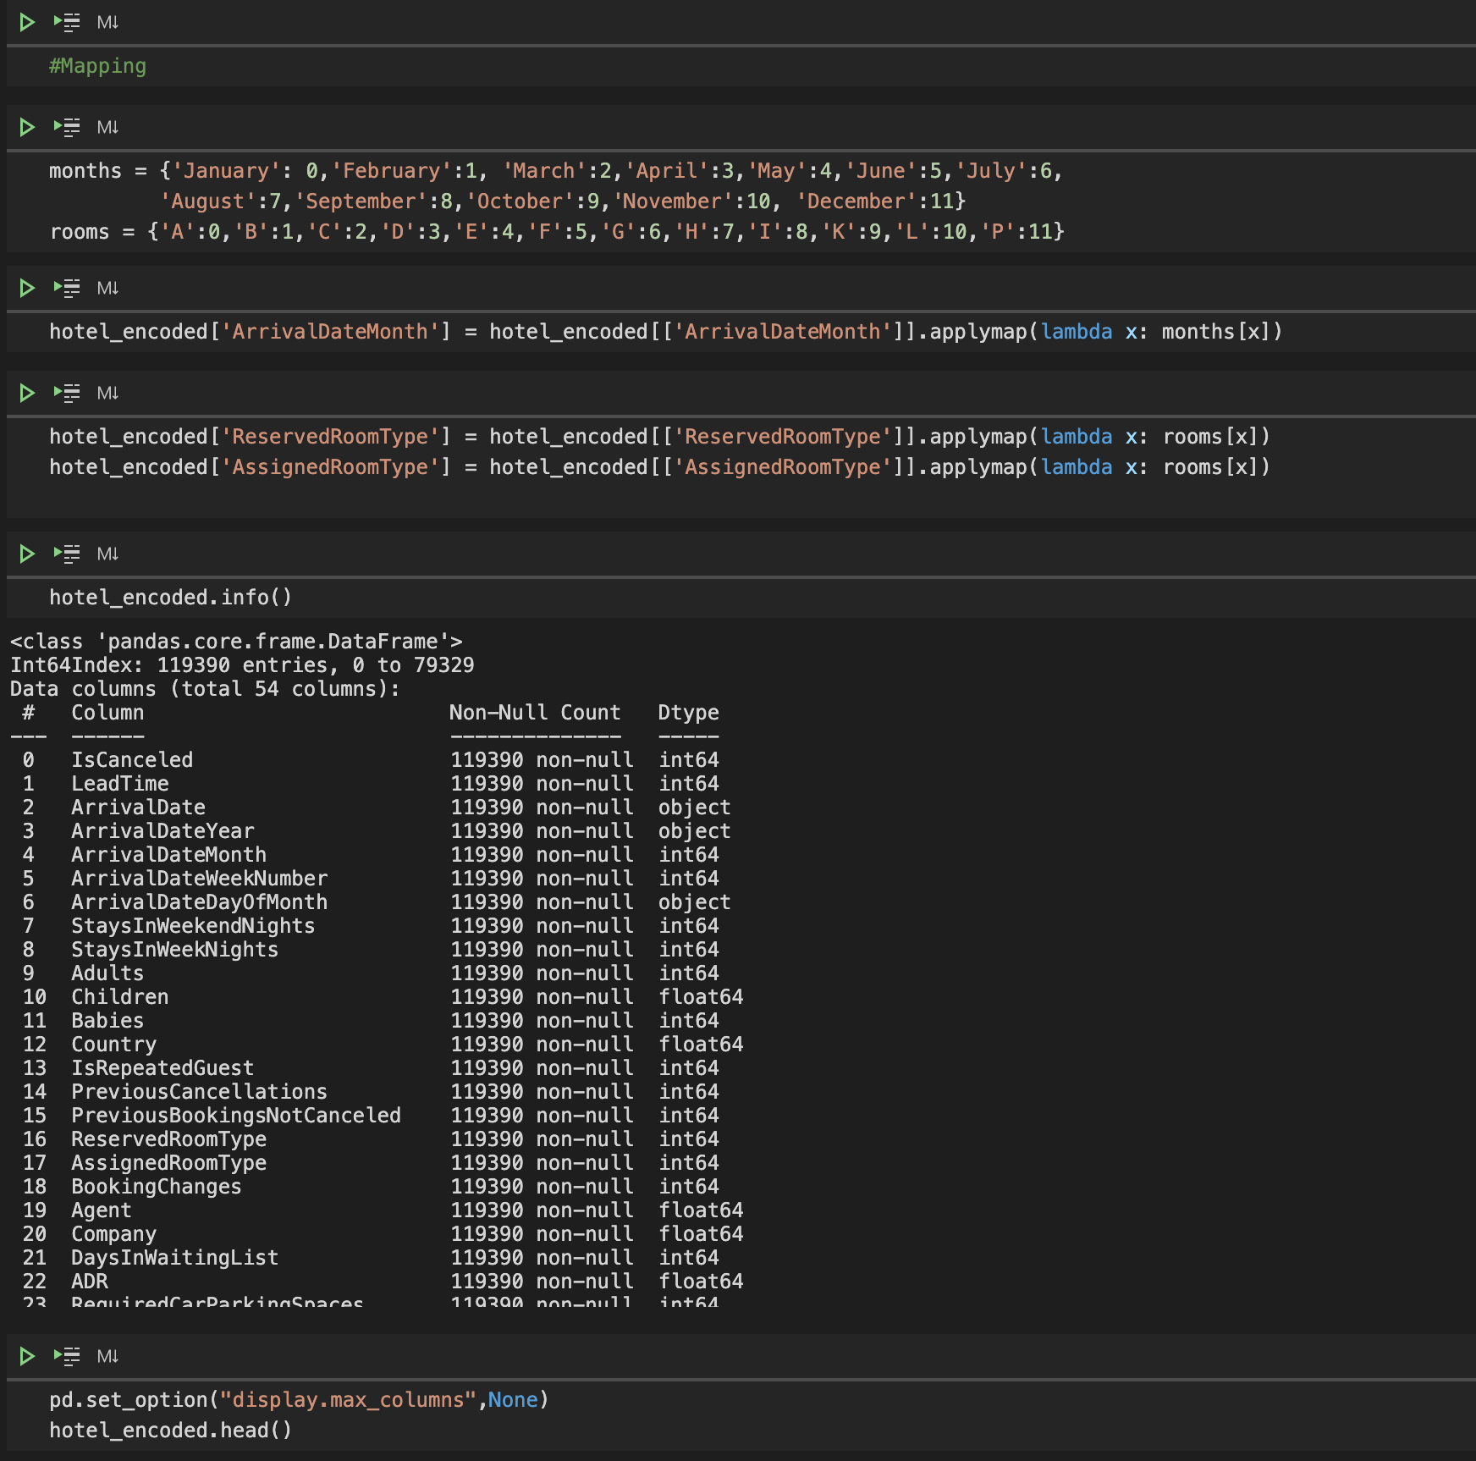
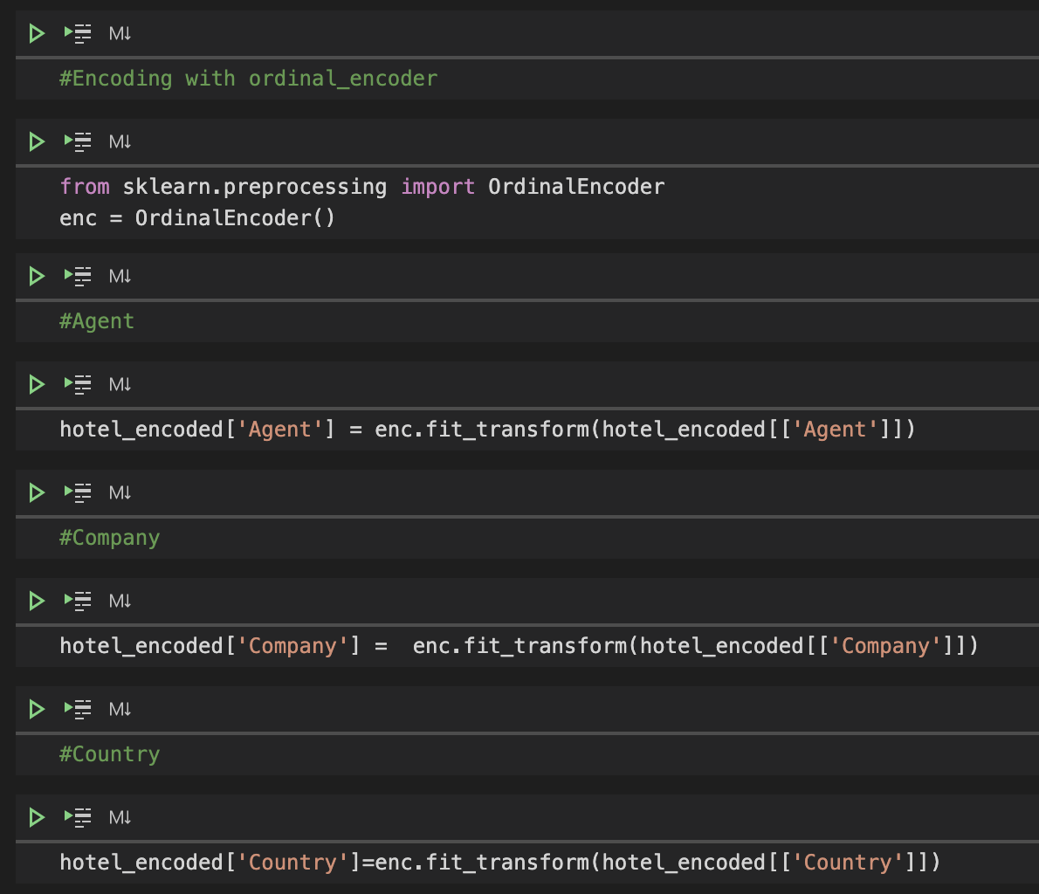
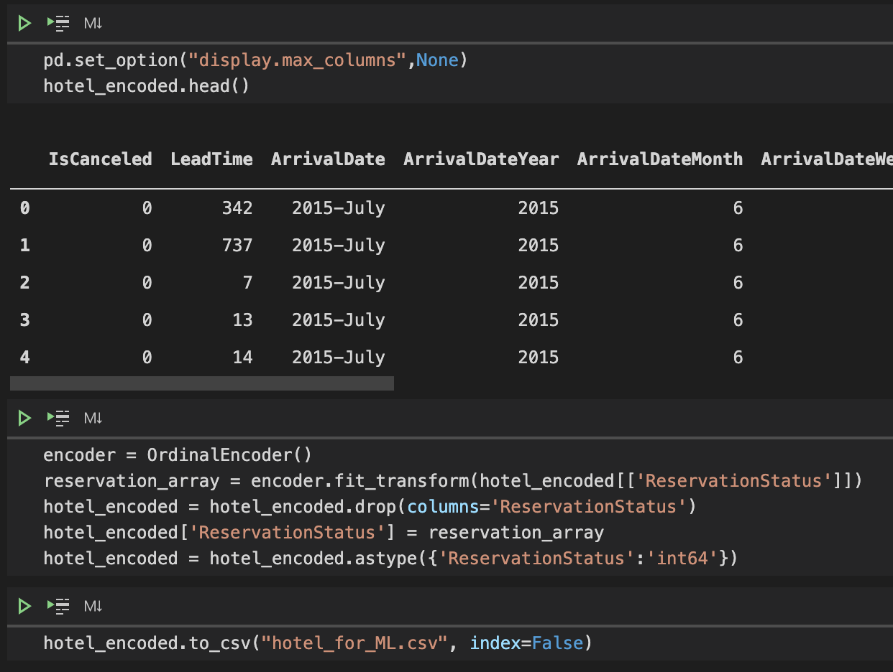
Data Cleaning
Merge Resort Hotel
and
City hotel
Mapping
data
Drop unnecessary
feature
and
fillna
Encoding with
get_dummies
and
ordinal_encoder
Notes:
The dataset contains data from two different hotels, resort hotel and city hotel, so first we need to combine them.
next, drop unnecessary feature and fill NA
third, encoding with get_dummies and ondinal encoder
last , mapping data for next step , build models.@

Slide 9
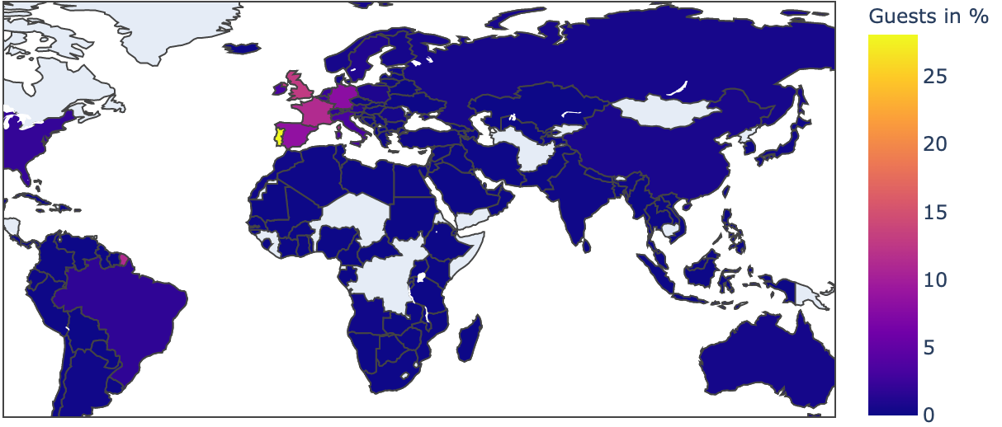
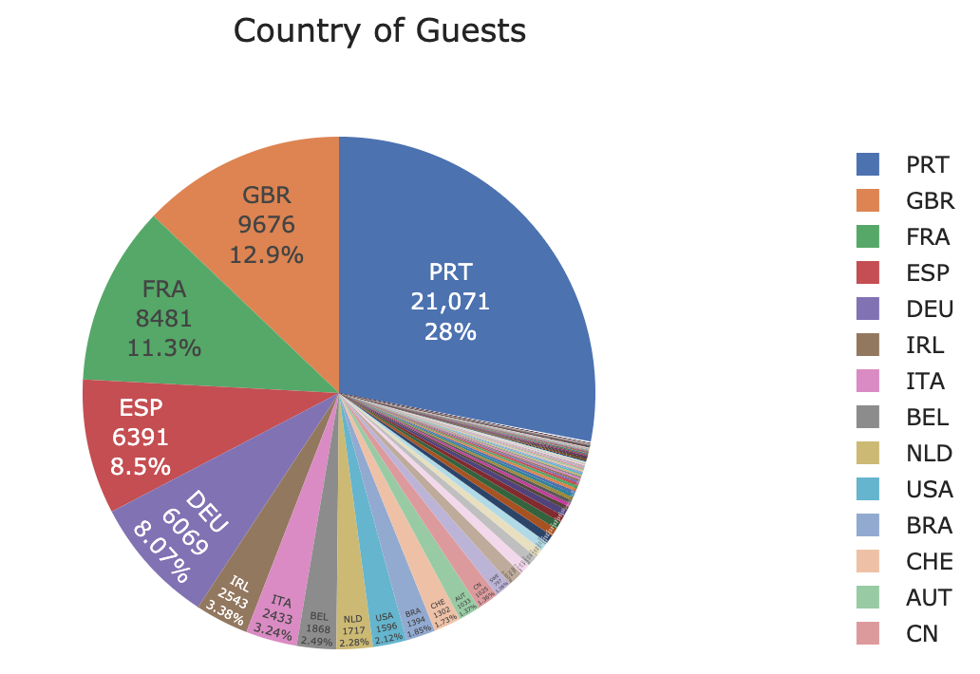



Country of guests
Most Guests from :
France
United Kingdom
Portugal
Notes:
Let’s talk about the EDA. Most guests are from Portgual, France and UK.

Slide 10
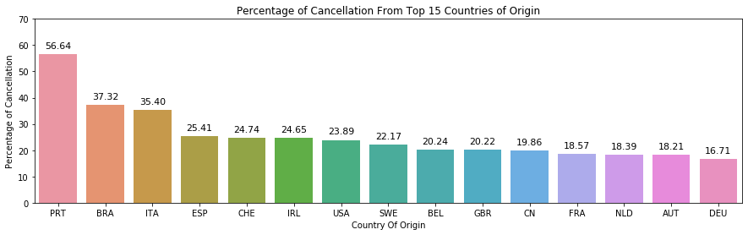
Notes:
Top cancellation guest are from Portgual, Brazil and Italy.

Slide 11
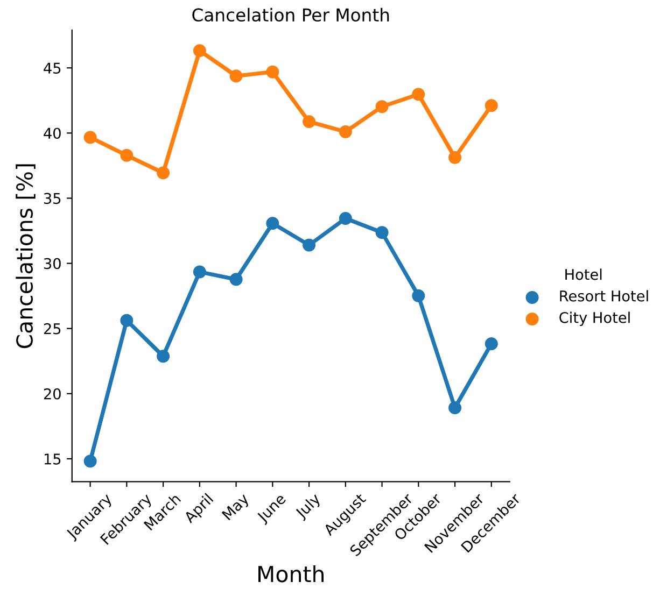
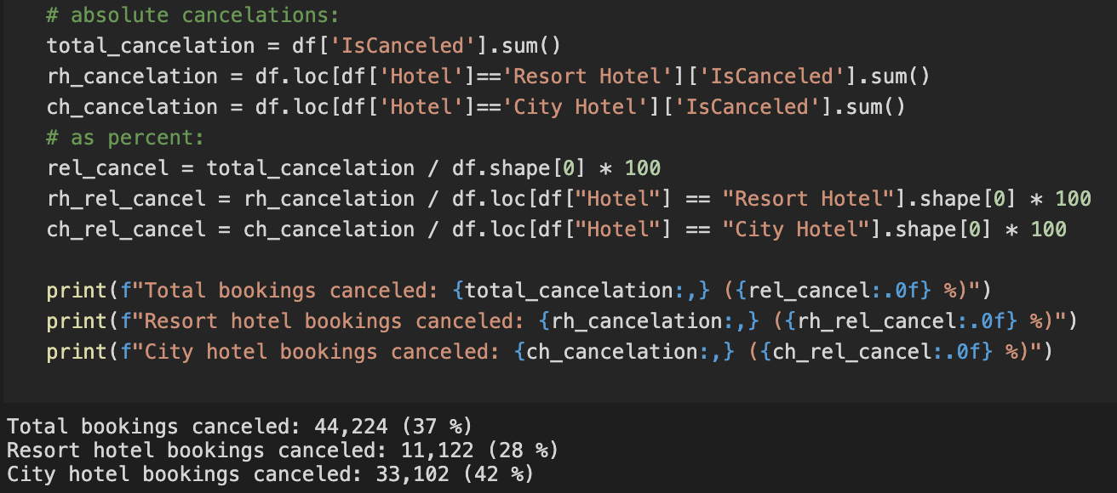

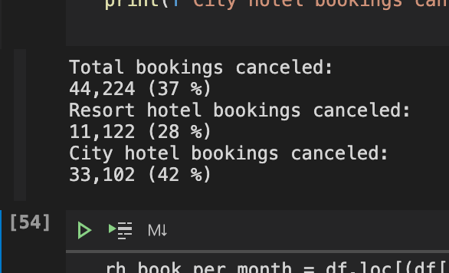
Cancellation of date
Notes:
Cancellation of Booking is City Hotel is Higher than Resort Hotel.
April to September in general has higher cancallations.

Slide 12
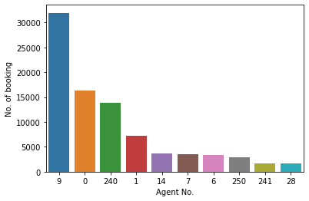
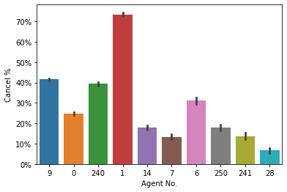
Notes:
In average, cancellation rate of customers with agent is about 40%.
Without agent, which is agent no 0 is about 25%.

Slide 13
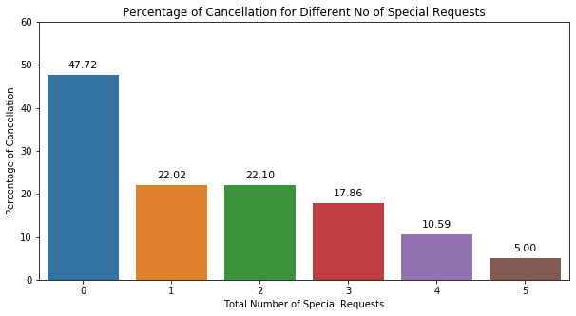
Notes:
Customers with less special request tends to have high cancel rate.

Slide 14
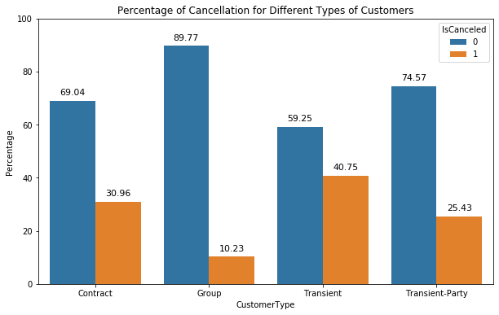
Notes:
Grouped Customers tends to have lower Canel rate

Slide 15
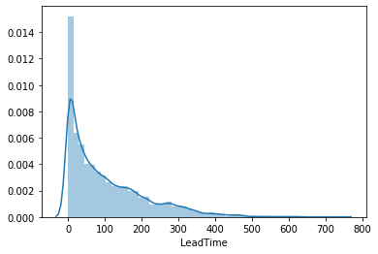
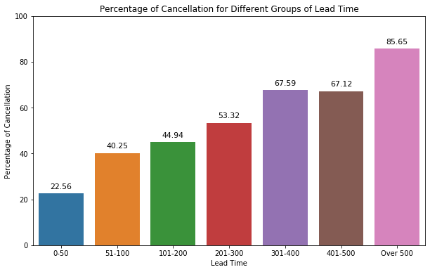
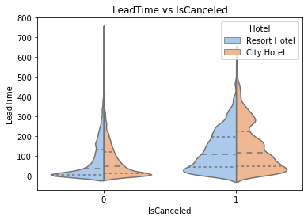
Notes:
Most customers have lead time within 50days.But in general, cancel rate is high if the lead time is more.

Slide 16

Models Creation
04

Slide 17
Kind of models used
Logistic Regression
Decision Tree Classifier
Random Forest Classifier
K Neighbors Classifier
Linear SVC
AdaBoost Classifier
XGB Classifier
Notes:
We have created 7 models for machine learning.

Slide 18
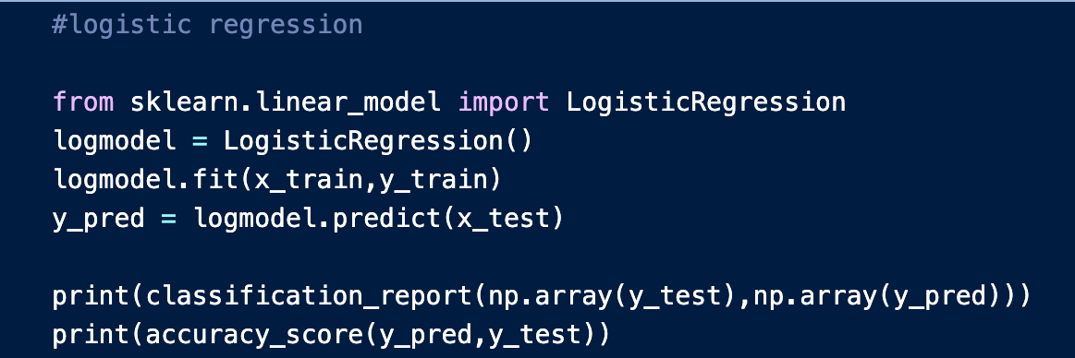
Logistic Regression
20,000
Logistic Regression
 | precision | recall | f1-score | support
0 | 0.80 | 0.91 | 0.86 | 15130
1 | 0.80 | 0.62 | 0.70 | 8748
accuracy |  |  | 0.80 | 23878
macro avg | 0.80 | 0.76 | 0.78 | 23878
weighted avg | 0.80 | 0.80 | 0.80 | 23878s
Accuracy : 74.22% (before tuning)
Accuracy : 80.44%

Slide 19
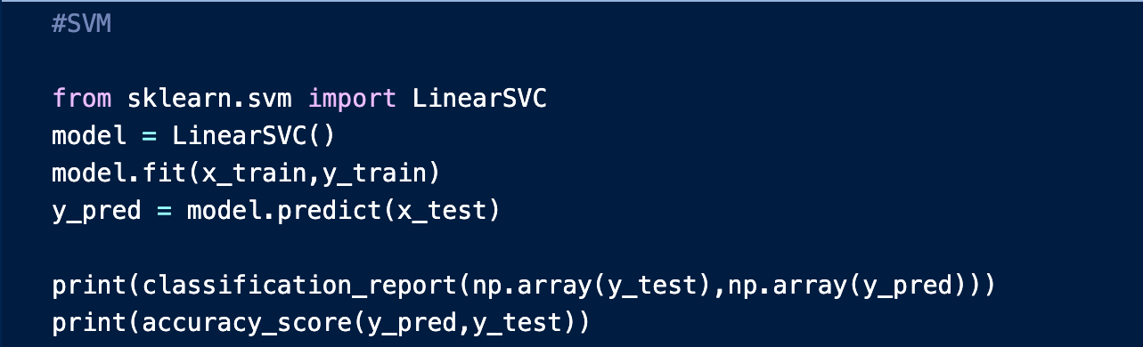
SVM
20,000
Support Vector Machine (Linear kernel)
 | precision | recall | f1-score | support
0 | 0.83 | 0.83 | 0.83 | 15130
1 | 0.71 | 0.71 | 0.71 | 8748
accuracy |  |  | 0.89 | 23878
macro avg | 0.77 | 0.77 | 0.77 | 23878
weighted avg | 0.79 | 0.79 | 0.79 | 23878
Accuracy : 77.13% (before tuning)
Accuracy : 78.83%

Slide 20
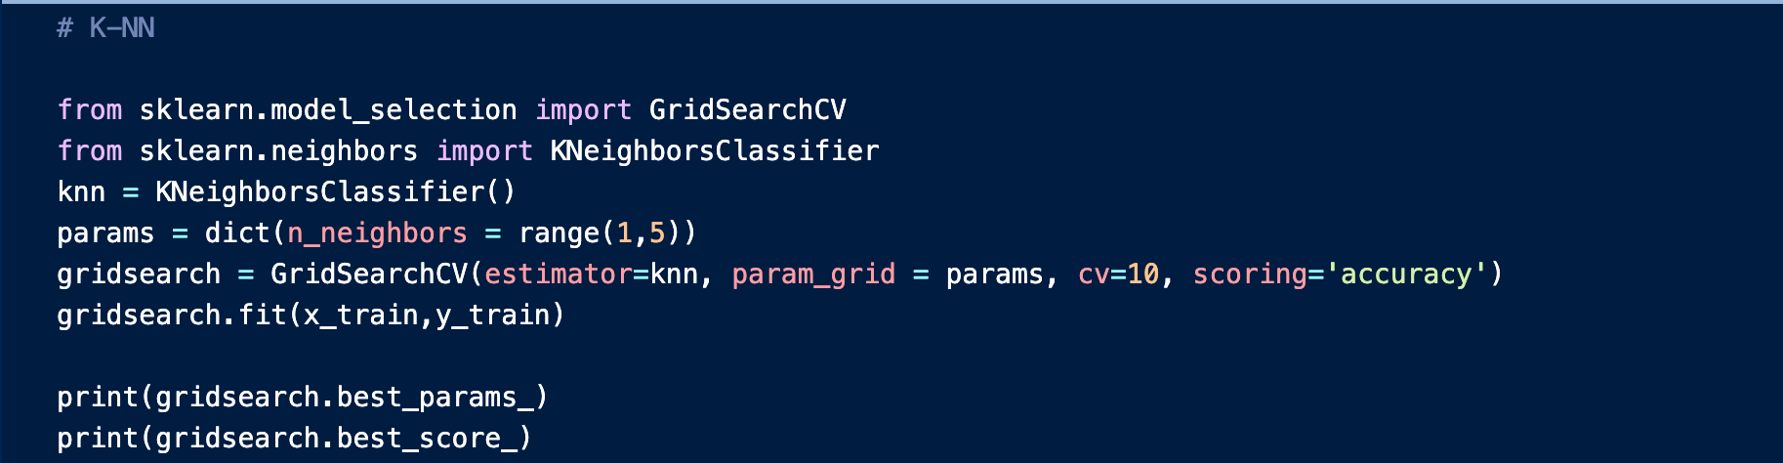
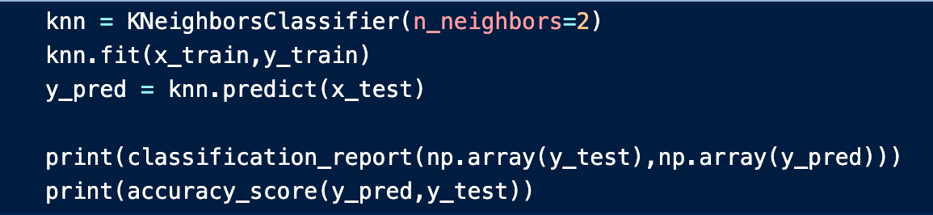
K-Nearest Neighbors
20,000
K-Nearest Neighbors
 | precision | recall | f1-score | support
0 | 0.81 | 0.93 | 0.86 | 15130
1 | 0.83 | 0.62 | 0.71 | 8748
accuracy |  |  | 0.82 | 23878
macro avg | 0.82 | 0.77 | 0.79 | 23878
weighted avg | 0.82 | 0.82 | 0.81 | 23878
Accuracy : 80.75% (before tuning)
Accuracy : 81.51%

Slide 21
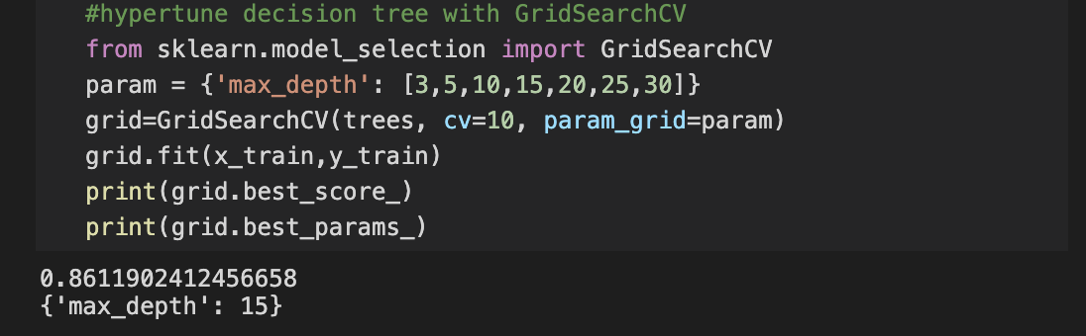
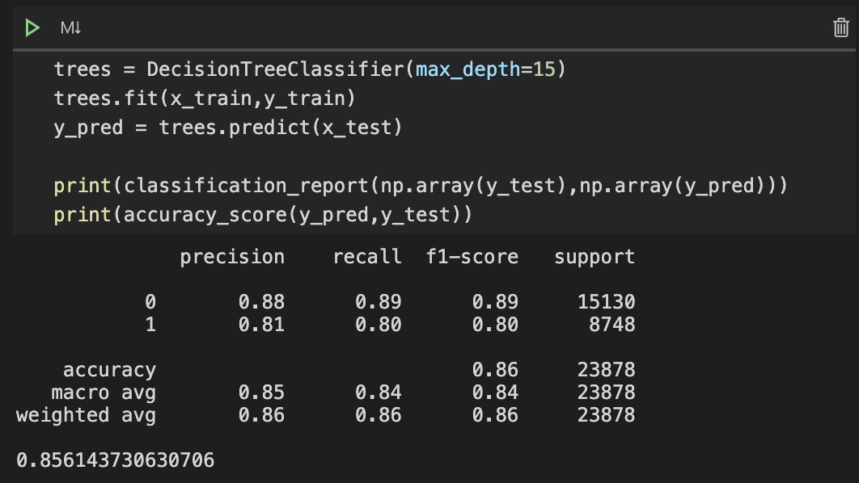
Decision Tree
20,000
Decision Tree
 | precision | recall | f1-score | support
0 | 0.88 | 0.89 | 0.89 | 15130
1 | 0.81 | 0.80 | 0.80 | 8748
accuracy |  |  | 0.86 | 23878
macro avg | 0.85 | 0.84 | 0.84 | 23878
weighted avg | 0.86 | 0.86 | 0.86 | 23878
Accuracy : 85.33% (before tuning)
Accuracy : 85.62%

Slide 22
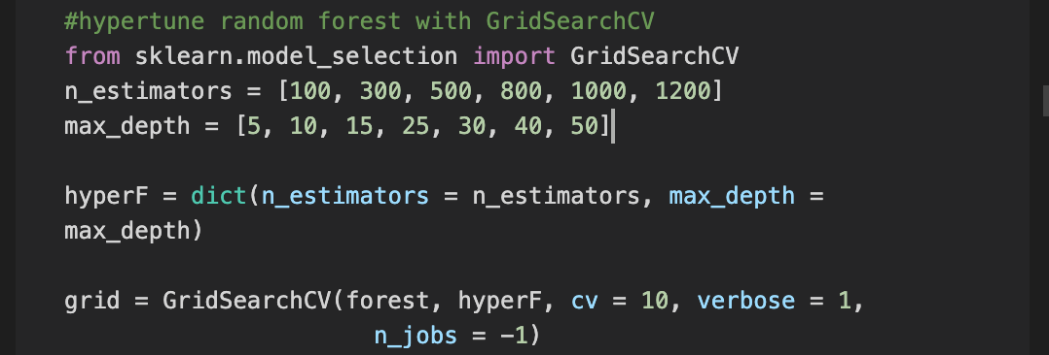
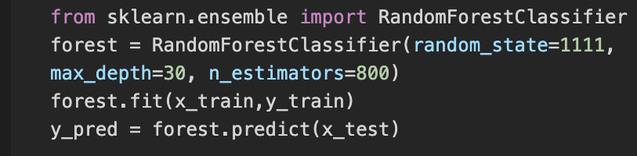
Random Forest
20,000
Random Forest
 | precision | recall | f1-score | support
0 | 0.90 | 0.94 | 0.92 | 15130
1 | 0.88 | 0.81 | 0.85 | 8748
accuracy |  |  | 0.89 | 23878
macro avg | 0.89 | 0.88 | 0.88 | 23878
weighted avg | 0.89 | 0.89 | 0.89 | 23878
Accuracy : 89.14% (before tuning)
Accuracy : 89.22%

Slide 23
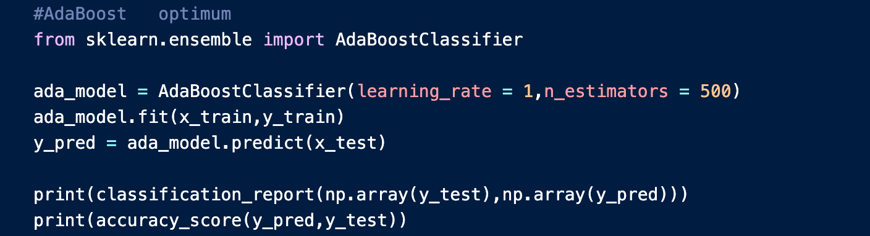
AdaBoost
20,000
AdaBoost Classifier
 | precision | recall | f1-score | support
0 | 0.81 | 0.93 | 0.86 | 15130
1 | 0.83 | 0.62 | 0.71 | 8748
accuracy |  |  | 0.82 | 23878
macro avg | 0.82 | 0.77 | 0.79 | 23878
weighted avg | 0.82 | 0.82 | 0.81 | 23878
Accuracy : 76.92% (before tuning)
Accuracy : 83.59%

Slide 24
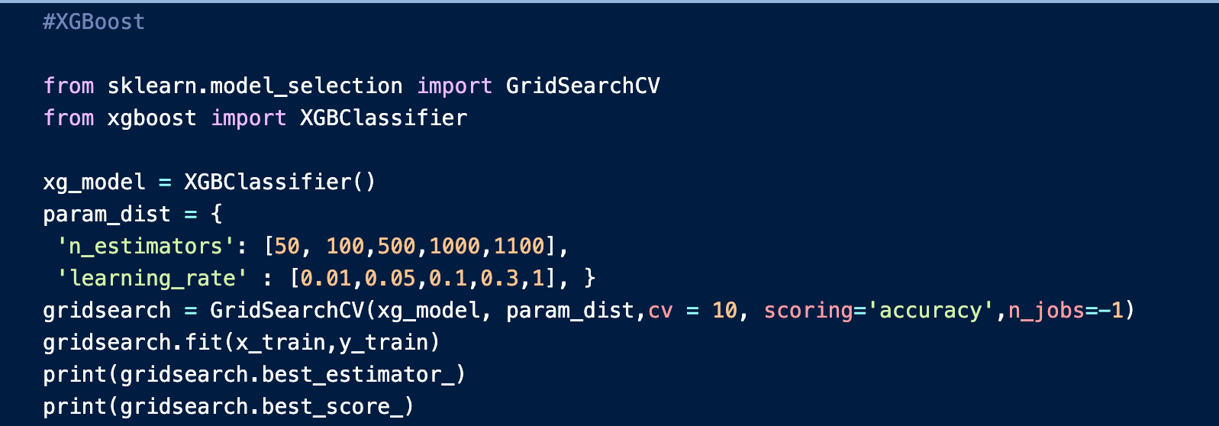
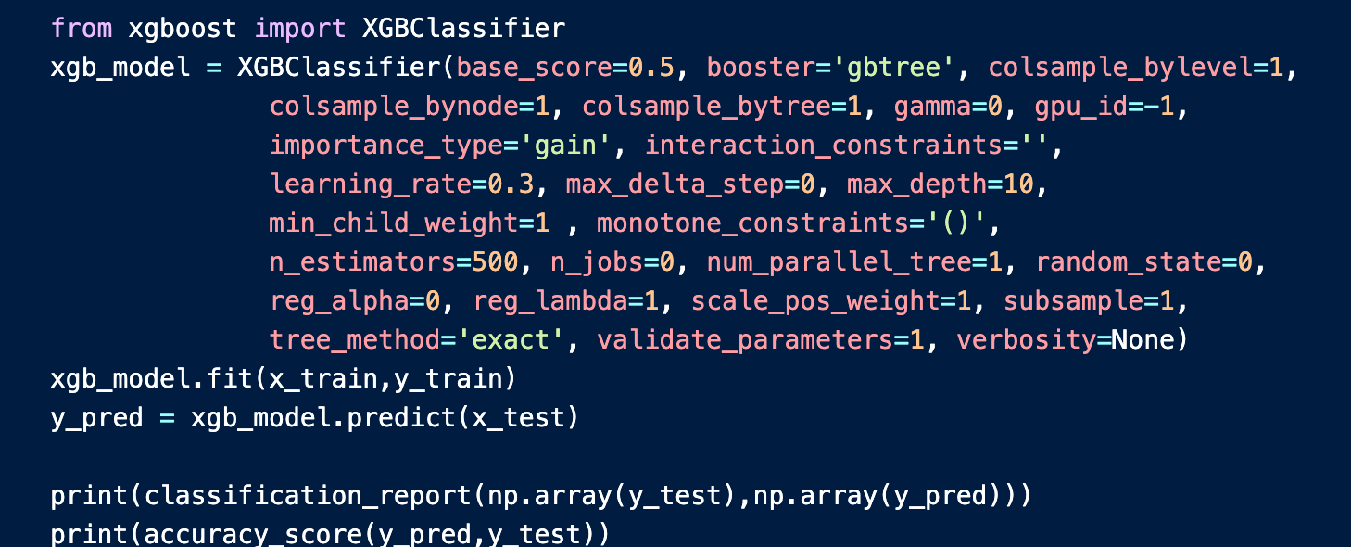
EXTREME GRADIENT BOOST
20,000
XGB Classifier
 | precision | recall | f1-score | support
0 | 0.91 | 0.93 | 0.92 | 15130
1 | 0.87 | 0.84 | 0.85 | 8748
accuracy |  |  | 0.89 | 23878
macro avg | 0.89 | 0.88 | 0.89 | 23878
weighted avg | 0.89 | 0.89 | 0.89 | 23878
Accuracy : 89.45%

Slide 25

05
Model Evaluation and Comparison

Slide 26
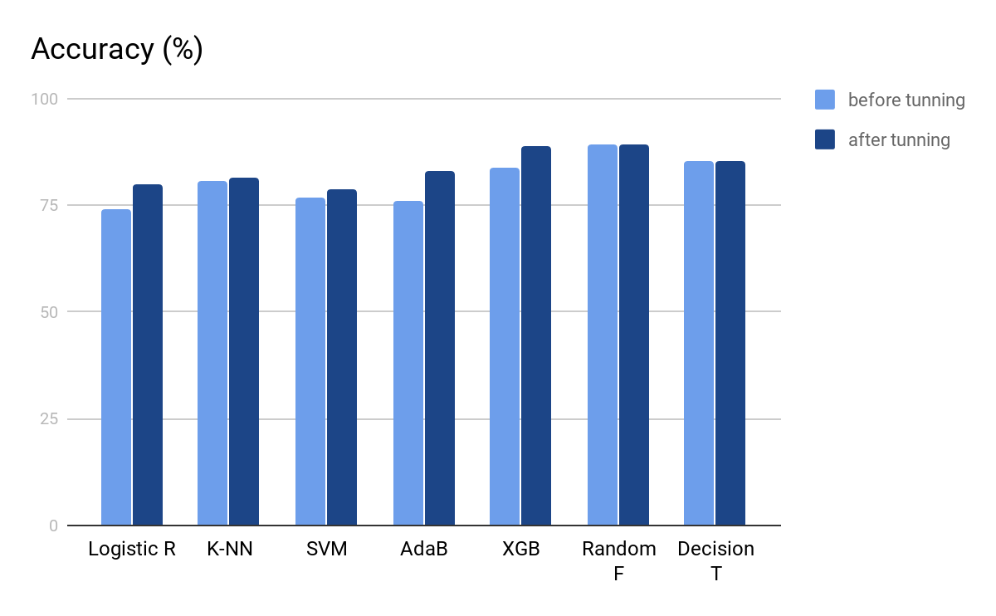
Accuracy for different models
Notes:
Here, we compare the accuracy score of all models before and after hyper tuning. We can see that Logistics regression, AdaBoost and XGB Classifier have greatest improvement in accuracy scores after hyper tuning. But overall, XGB and Random Forest have highest accuracy scores, which are around 89%.

Slide 27
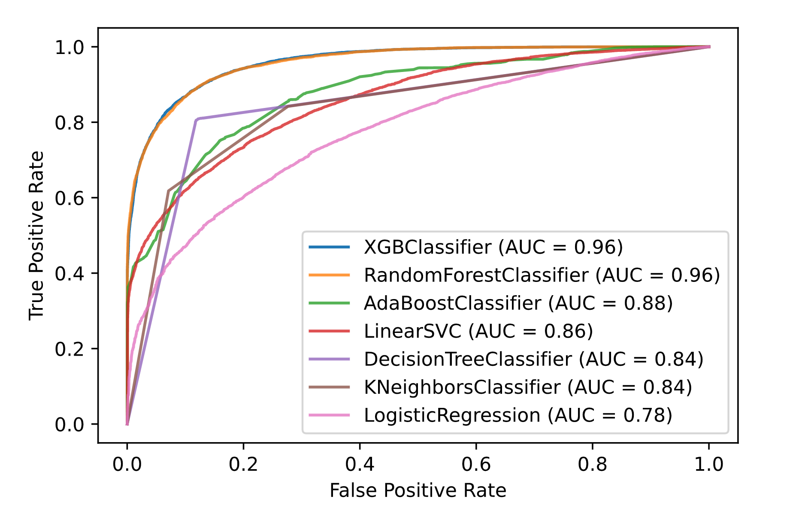
ROC Analysis
ROC analysis on different models
XGB Classifier & Random Forest Classifier perform the best.
Logistic Regression performs the worst
Notes:
We also did a ROC analysis on different models. Here, we can also see the plots for XGB and Random Forest are higher than the rest of the ROC curves, which indicate that they are best for classifying the dataset correctly. On the other hand, the pink curve for logistic regression is closest to the centre and performs the worst.

Slide 28
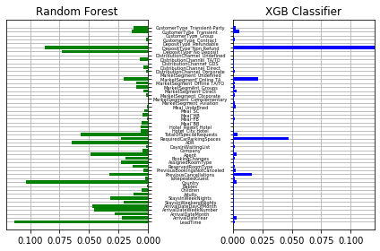
SKLearn Feature Importance Comparison
No Refund 0.847!
Notes:
After finishing the models, we used the SKLearn in-built feature importances to get the weights of the features. For random forest, there are around 10 features that have particularly high weights. On the other hand, for XGB classifier, there is a feature with disproportionately high weight, which is a no refund deposit type and it has a weight of 0.847.

Slide 29
SKLearn In-built Feature Importance Comparison
Random Forest
Country | 0.1131
TotalOfSpecialRequests | 0.1037
Agent | 0.0878
LeadTime | 0.0732
MarketSegment_Online | 0.0646
PreviousCancellations | 0.0570
ArrivalDateYear | 0.0483
AssignedRoomType | 0.0475
CustomerType_Transient | 0.0458
RequiredCarParkingSpaces | 0.0329
XGB Classifier
Country | 0.8470
LeadTime | 0.0473
Agent | 0.0216
TotalOfSpecialRequests | 0.0161
DepositType_Non Refund | 0.0052
ReservedRoomType | 0.0040
AssignedRoomType | 0.0033
PreviousCancellations | 0.0030
ArrivalDateYear | 0.0030
MarketSegment_Online TA | 0.0030
Notes:
Here, we list the 10 most important features for the two models, and then use only these 10 features to train the two models again.

Slide 30
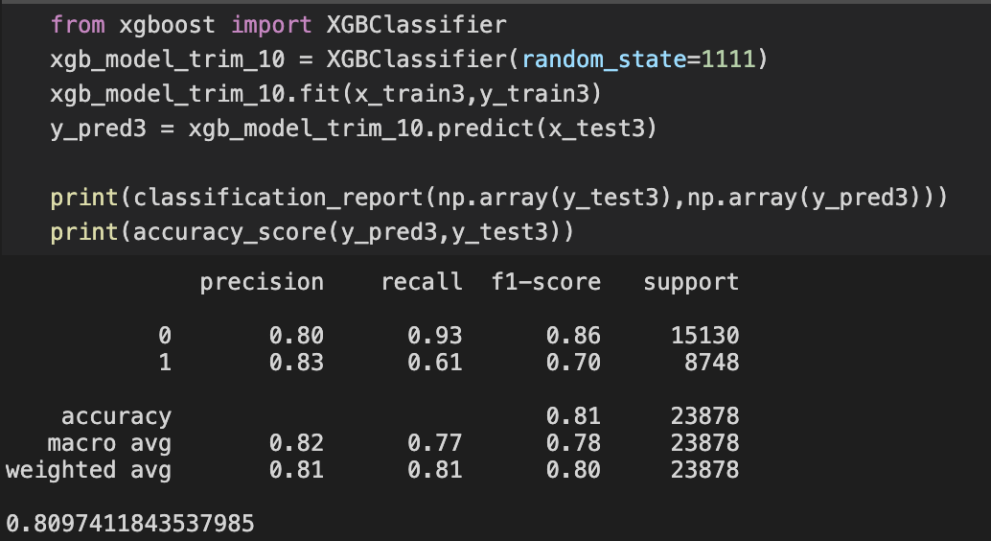
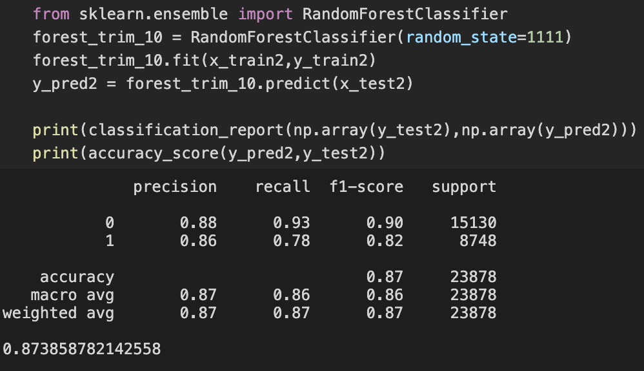
Using only the 10 most important features...
Random Forest
Accuracy:
87.39%
Feature Importance Comparison
XGB Classifier
Accuracy:
80.97%
Efficiency
vs
Accuracy
Notes:
Without hyper tuning, we can see that random forest now have an accuracy of 87% while XGB has 81%. We can see that although we are only using 10 of the 50 features, the accuracy is still relatively high, showing that using only the features with high weight can allow us to train models more efficiently and without the cost of getting too much information while at the same time retaining a high enough accuracy scores.

Slide 31
Permutation Importance Comparison
Random Forest
Country | 0.069
TotalOfSpecialRequests | 0.059
Agent | 0.049
LeadTime | 0.042
MarketSegment_Online | 0.031
PreviousCancellations | 0.023
ArrivalDateYear | 0.021
AssignedRoomType | 0.017
CustomerType_Transient | 0.014
RequiredCarParkingSpaces | 0.012
XGB Classifier
Country | 0.084
LeadTime | 0.055
Agent | 0.050
TotalOfSpecialRequests | 0.046
DepositType_Non Refund | 0.038
ReservedRoomType | 0.037
AssignedRoomType | 0.037
PreviousCancellations | 0.027
ArrivalDateYear | 0.025
MarketSegment_Online TA | 0.024
Notes:
We also get the 10 most important features by permutation importance, and this time, we can see that the XGB’s features have more proportionate weights, which mean the features are more likely given due consideration by the models.

Slide 32
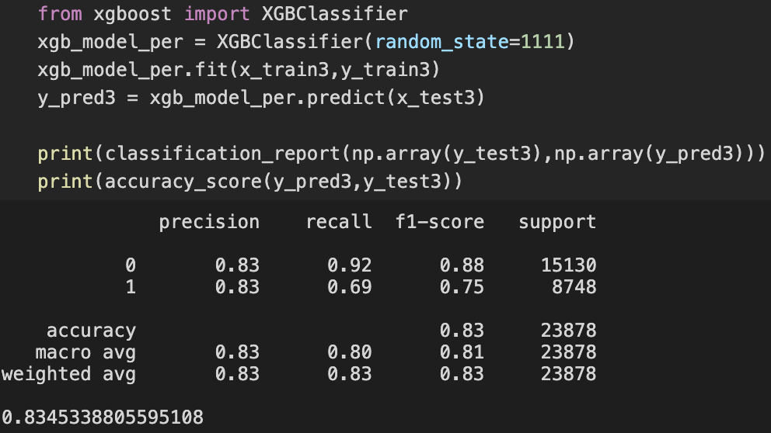
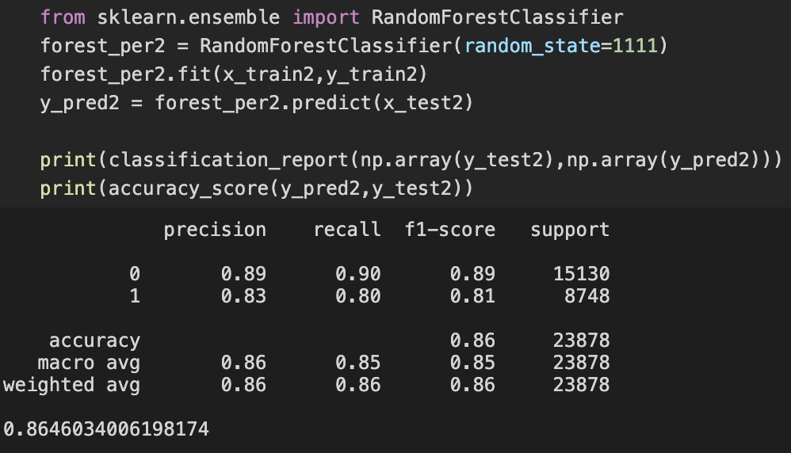
Similarly,
using only the 10 most important features...
Random Forest
Accuracy:
86.46%
Feature Importance Comparison
XGB Classifier
Accuracy:
83.45%
Smaller decrease in accuracy for XGB Classifier, but greater drop for Random Forest
Notes:
This time, random forest has an accuracy of 86% while XGB has an accuracy of 83%. Although there is a greater drop in accuracy for random forest, we can wee XGB retain more accuracy score.

Slide 33
Permutation Importance is suitable for XGB Classifer
SKLearn In-built FI performs better with Random Forest
Overall, important features include:
Country of Origin
Lead Time
Deposit Type
Previous Cancellations
Total Number of Special Requests
Required Number of Parking Spaces
Feature Importance Summary
Notes:
In summary, it seems that for our dataset, permutation importance is more suitable for XGB classifier, while SKLearn in-built feature importance is better with Random Forest. From the analysis, we can also derive some important features that hotels can consider, including country of origin, lead time, deposit type, previous cancellations, total number of special requests, and required number of parking spaces.
https://explained.ai/rf-importance/
in-built: mean decrease in impurity (or gini importance) mechanism (check out the Stack Overflow conversation). The mean decrease in impurity importance of a feature is computed by measuring how effective the feature is at reducing uncertainty (classifiers) or variance (regressors) when creating decision trees within RFs. The problem is that this mechanism, while fast, does not always give an accurate picture of importance.
permutation: Record a baseline accuracy (classifier) or R² score (regressor) by passing a validation set or the out-of-bag (OOB) samples through the Random Forest. Permute the column values of a single predictor feature and then pass all test samples back through the Random Forest and recompute the accuracy or R². The importance of that feature is the difference between the baseline and the drop in overall accuracy or R² caused by permuting the column.

Slide 34

06
Future Improvement

Slide 35


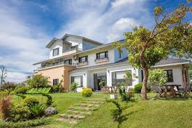
Future improvement
Try other feature importance calculation
Collect data from hotels in other countries
Collect data which is more updated and credible
For example,
Drop column feature importance
SHAP values
For example, hotels from Asia
Notes:
For improvement,
we can try other feature such as drop column feature importance and by using SHAP values.
We can collect more hotel data all over the world.
We can collect data which is more updated and credible.

Slide 36
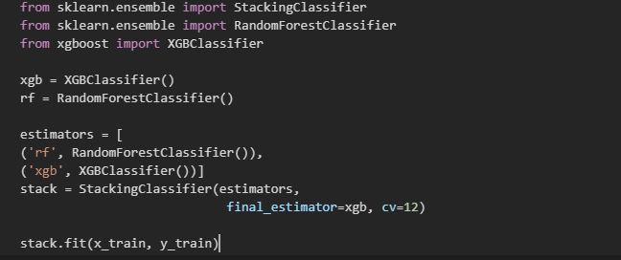
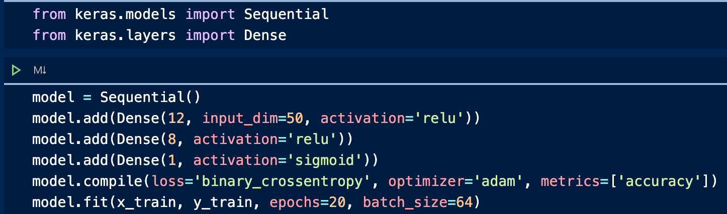
Further improvement
Stacking
Deeping Learning
accuracy: 89.31%
accuracy: 76% (>_<).sigh…...
Notes:
We can also do stacking and deep learning for improvement.

Slide 37

Let’s see the model’s performance~

Slide 38


AI
Imagine now you are going to book a hotel.
And our AI will predict if you would cancel your hotel or not in the foreseeable future...

Slide 39
Main feature 1
Please tell us:
Hotel type
(Which type of hotel you wanna live ???)
city hotel?
resort hotel?

Slide 40
Main feature 2
Please tell us:
Lead-time
(Number of days that elapsed between the entering date of the booking and the arrival date)

Slide 41
Main feature 3
Please tell us:
Stay duration
(How long will you stay in the hotel?)

Slide 42
Main feature 3
Please tell us:
Deposit type
No Deposit – no deposit was made;
Non Refund – a deposit was made in the value of the total stay cost;
Refundable – a deposit was made with a value under the total cost of stay.

Slide 43
Default Features
CustimerType
Distribution Chnnal
Day in waiting list
Previous booking
Agent
ADR
...
...
Arrival date:2020-10-5
adult:1
children:0
baby:0
country:China
Meal:breakfast
Is Repeated Guest:false
market segment:online

Slide 44


Loading ...
...
please wait patiently~~~

Slide 45

THANKS
Does anyone have any questions?

